Slide 2
Using LTPPBind to Select Crack-Sealing Materials
Typical specifications for crack-sealing materials include sealant property evaluations at high, moderate, and low temperatures.
The evaluations provide information on materials characteristics at those temperatures.
Using LTPPBind, sealant properties at anticipated high and low temperatures can be evaluated or compared.

Slide 3
Using LTPPBind to Select Crack-Sealing Materials
Obtain LTPPBind and LTPP Section data from the Long Term Pavement Performance (LTPP) program using LTPP InfoPave, by the following steps..

Slide 4
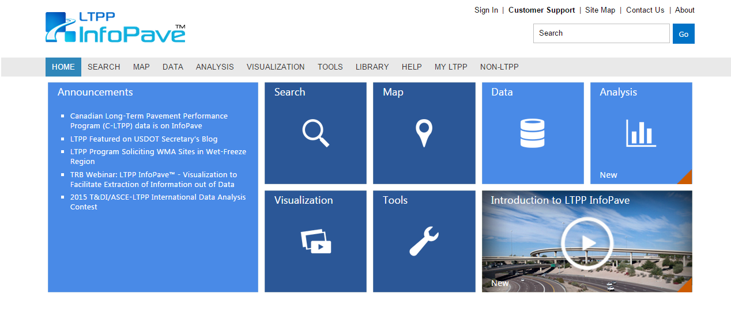
Crack-Sealing Materials: Step 1...
www.InfoPave.com
Register or Sign in.

Slide 5
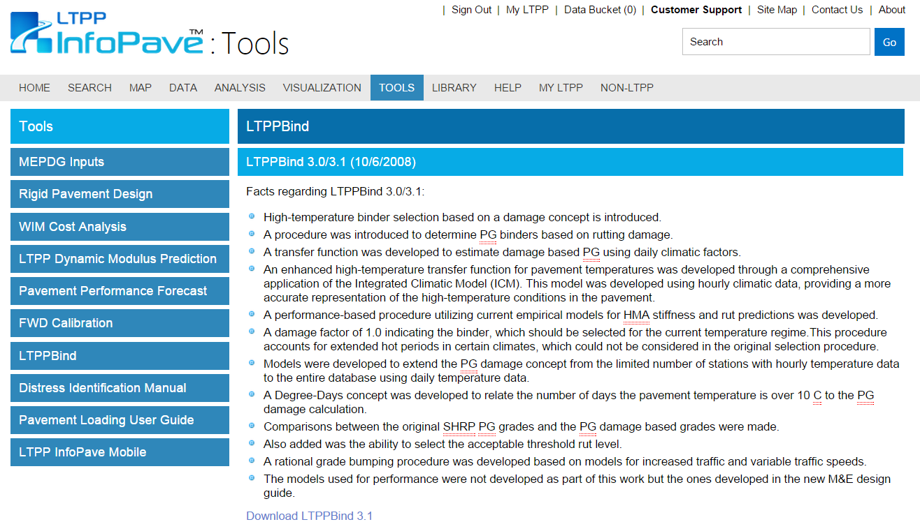
Crack-Sealing Materials: Step 2...
http://www.infopave.com/Page/Index/LTPP_BIND
Go to: Tools
Go to: LTPPBlind
Download
and Install

Slide 6
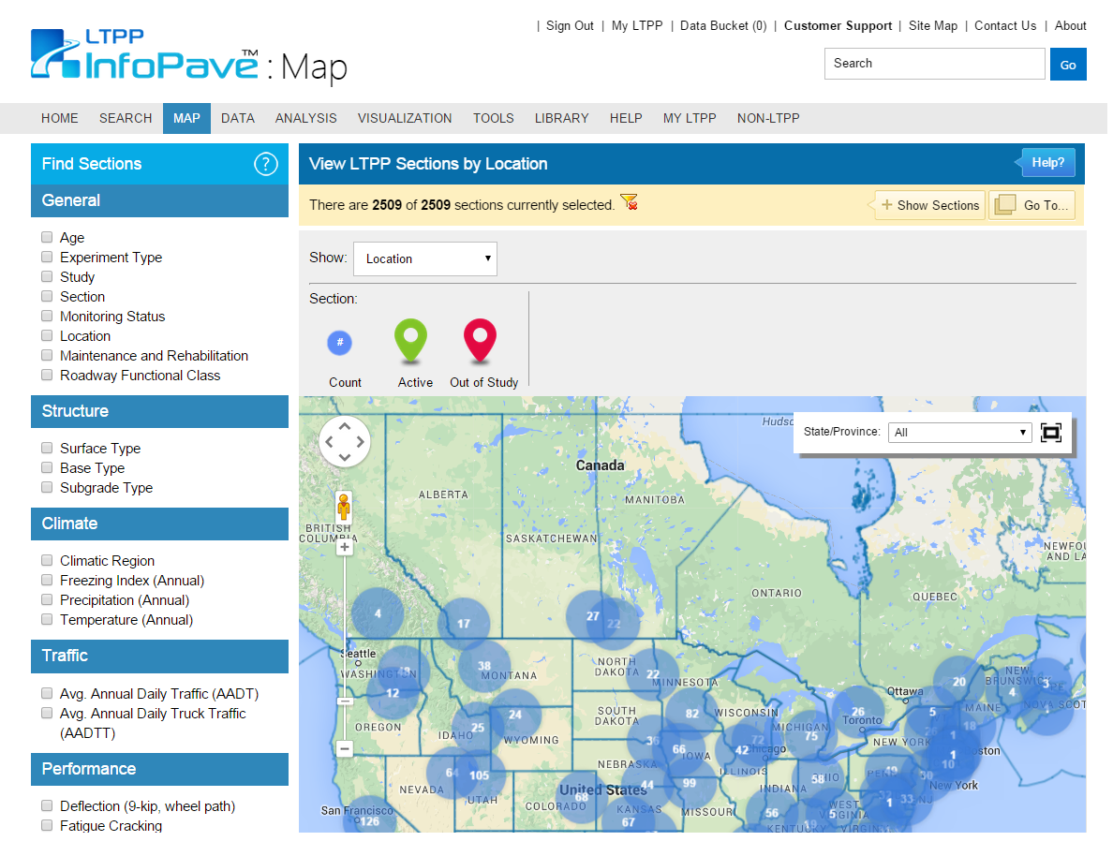
Crack-Sealing Materials: Step 3...
www.InfoPave.com/Map/ByLocation/
Locate which sections pertain to your study.
Use filters to narrow search parameters.

Slide 7
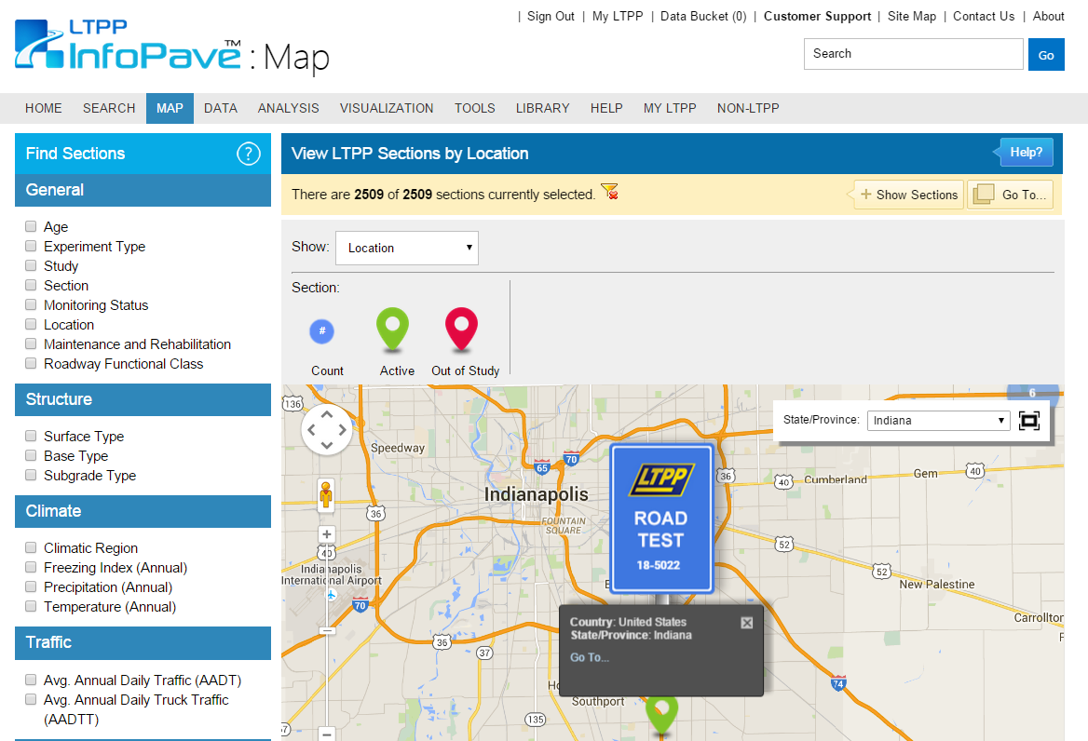
Crack-Sealing Materials: Step 3...
www.InfoPave.com/Map/ByLocation/
Click desired section
Click “Go To...”

Slide 8
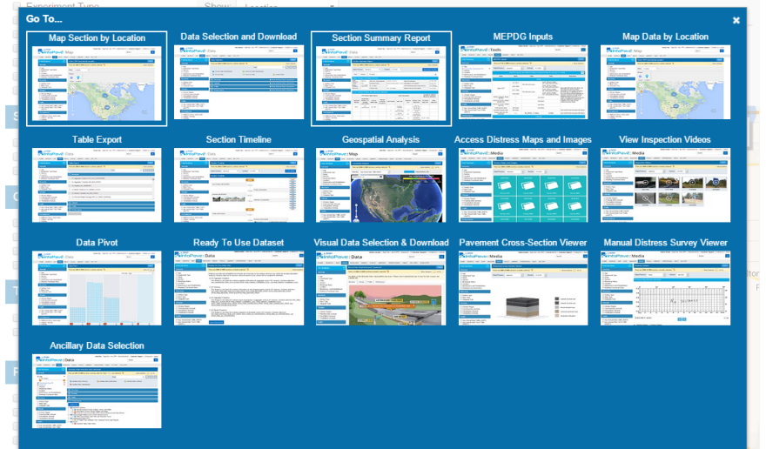
Crack-Sealing Materials: Step 3...
www.InfoPave.com/Map/ByLocation/
Click “Section Summary Report”

Slide 9
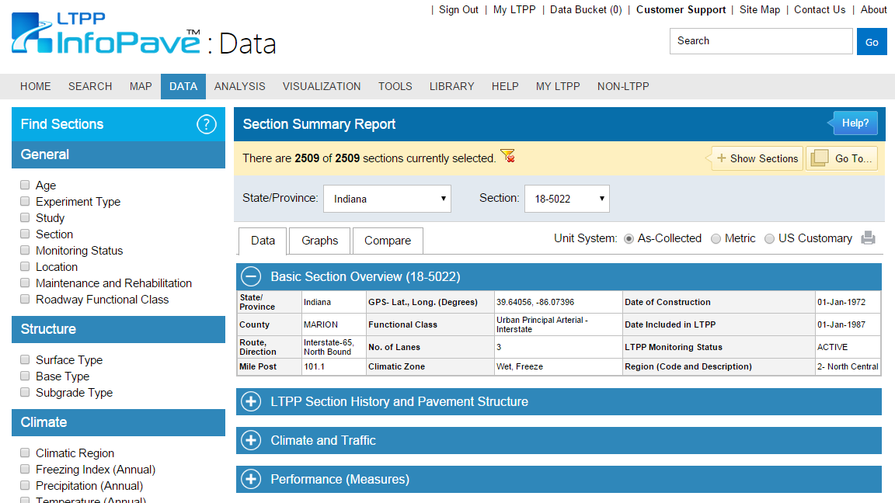
Crack-Sealing Materials: Step 4...
http://www.infopave.com/Data/SectionSummaryReport/?Section=18-5022
Retrieve GPS coordinates and traffic data

Slide 10
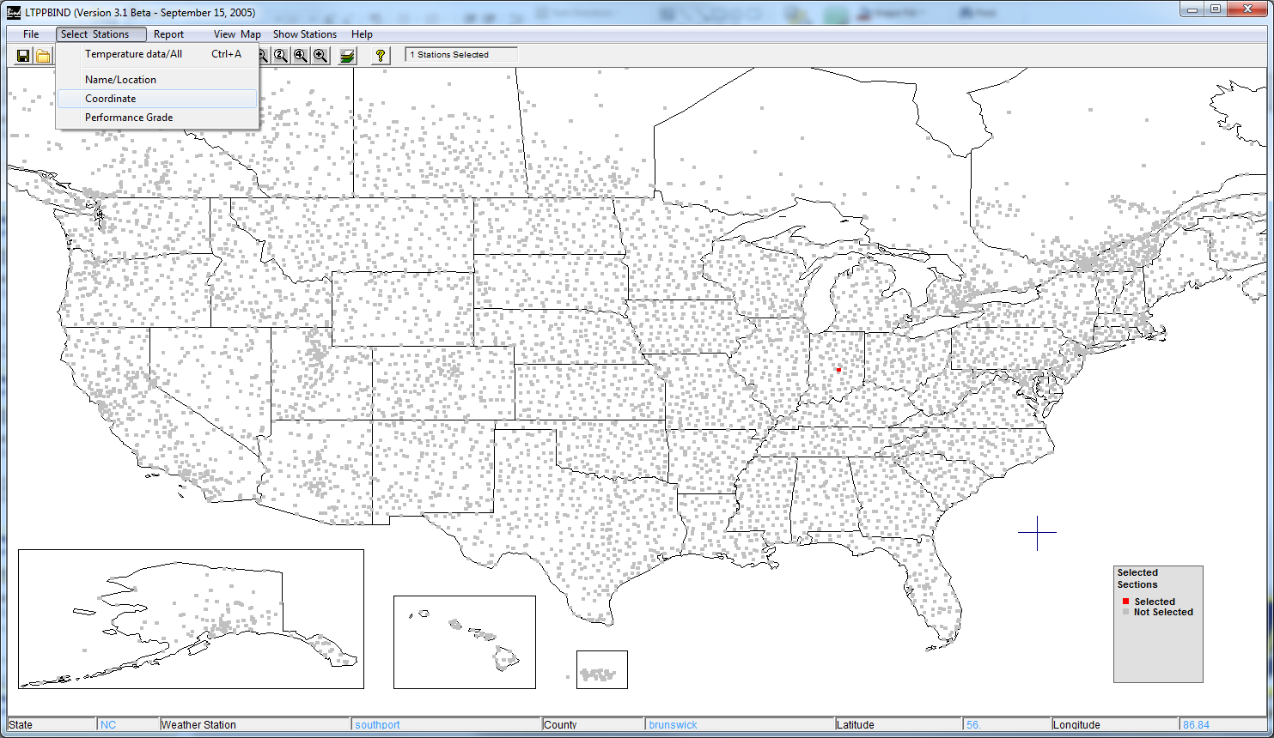
Crack-Sealing Materials: Step 5...
LTPPBind
Open LTPPBind
Click “Select Sections”and “Coordinate”

Slide 11
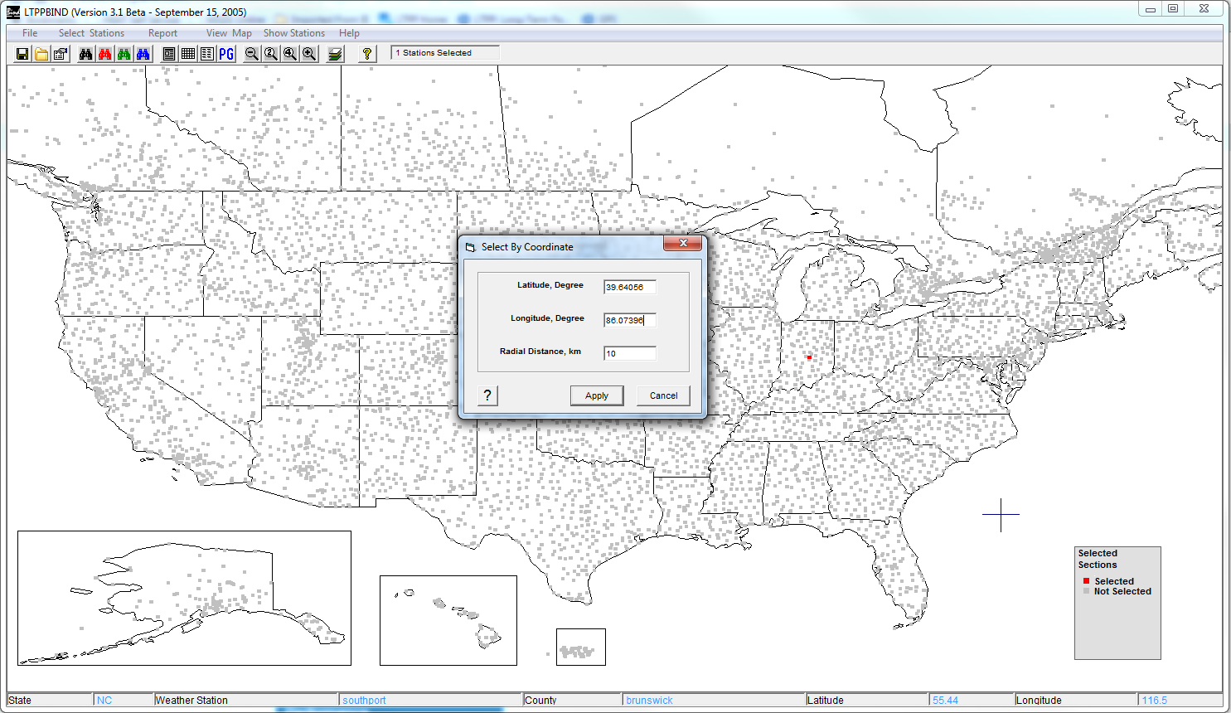
Crack-Sealing Materials: Step 5...
LTPPBind
Enter GPS coordinates from LTPP InfoPave
Click “Apply”

Slide 12
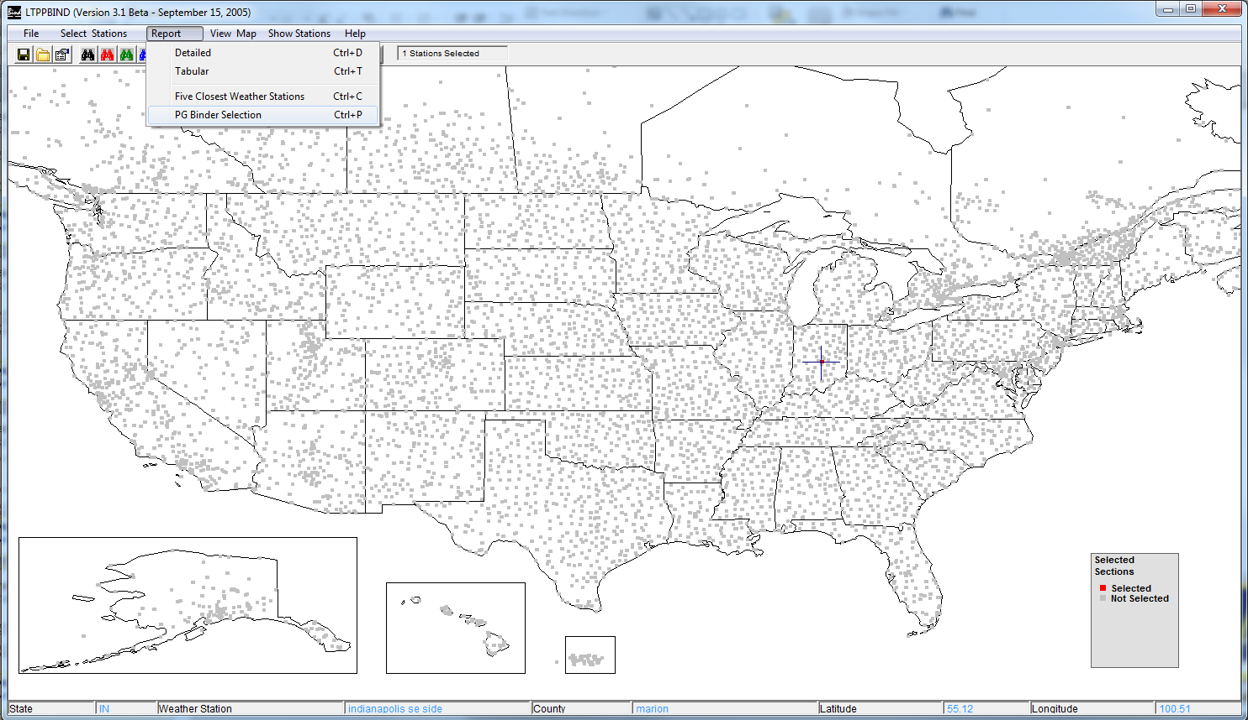
Crack-Sealing Materials: Step 6...
LTPPBind
Click “Report”
Click “PG Binder Selection”

Slide 13
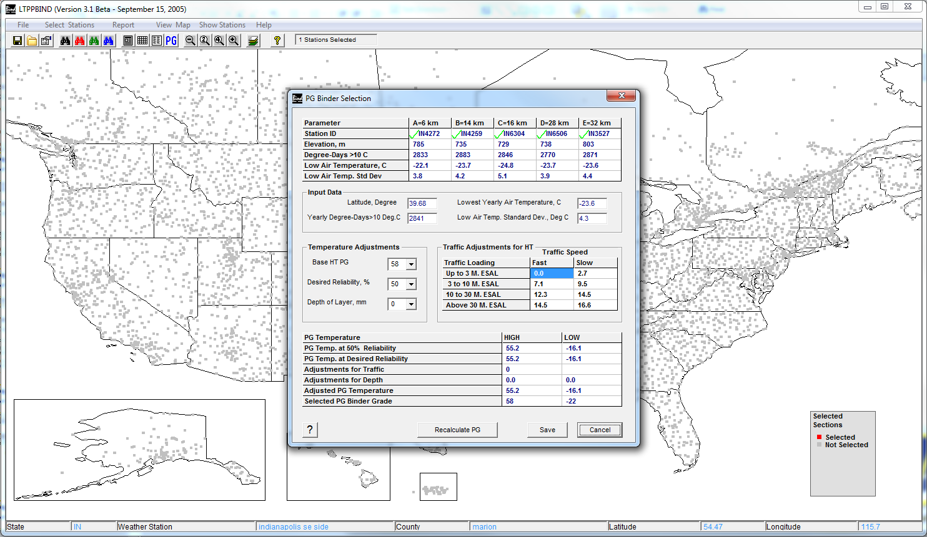
Crack-Sealing Materials: Step 6...
Determine high and low temperatures and save data for reference.

Slide 14
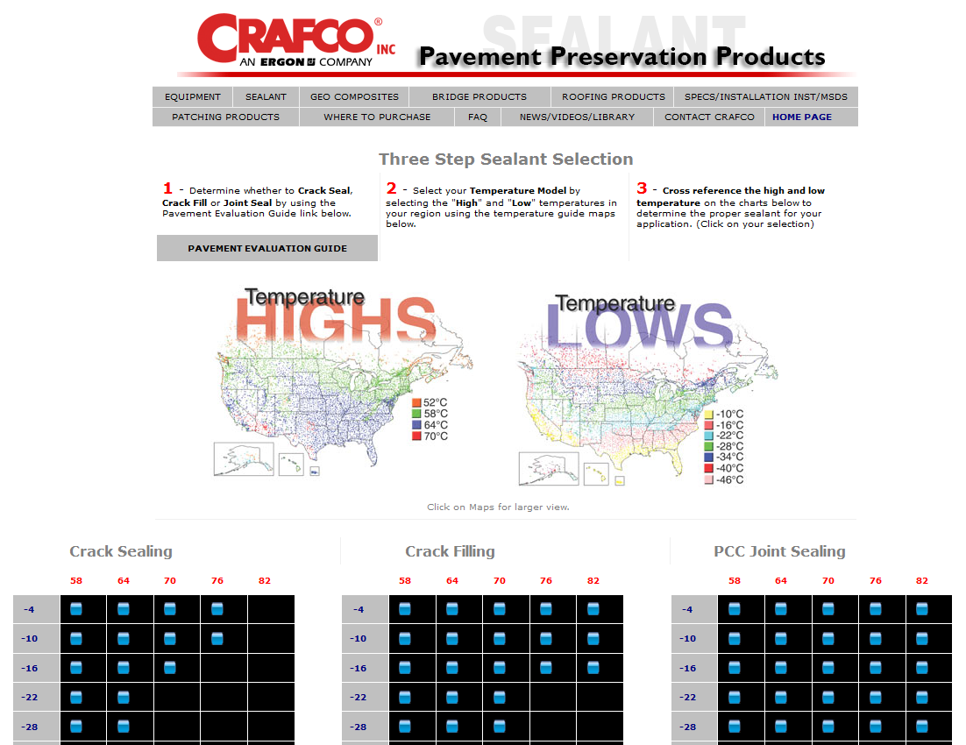
Crack-Sealing Materials: Step 7...
http://www.crafco.com/Sealant/Selection%20Guide.htm
Reference a local/available sealant manufacture to select the appropriate sealant.
Follow the guidelines provided.

Slide 15
Using LTPPBind to Select Crack-Sealing Materials
An improved understanding of pavement temperatures and corresponding material properties helps highway agencies determine the sealant materials and installation methods that provide the best results.
Using LTPPBind to design and select crack-sealing treatments will help improve pavement performance, ensure longer-lasting treatments, reduce repairs, and decrease life-cycle costs.

Slide 16
Questions?

Slide 17
References
Antonio Nieves. Using LTPPBind to Improve Crack Sealing in Asphalt Concrete Pavements. FHWA-RD-03-080, HRDI-013/12-03(X00)E, December 2003
Crafco Inc., Sealant Selection Guide. www.crafco.com.
Long Term Pavement Performance. LTPP InfoPave. www.infopave.com.

